Slide 1

AgriCrop
supervisor:
Dr. Gibrael abo samra
Group members:
Osama Alamri
Abdulaziz AL Malky
Ahmed Balamsh

Slide 2
Table of Contents
01
02
03
04
05

Slide 3
Introduction
Agricrop is a solution in the agriculture Area that targets business-to-business sector to solve a problem that has been touching it in reality.
the solution is a mediator platform between farmers and agricultural businesses sector, whether are in industry, retail, or restaurant businesses.

Slide 4
Problem Statement
lack of options to buy agricultural crops
difficulty to reach to specific crop
limitation to sell in specific places for local farmers

Slide 5
Objectives
Create technology Solution to fill this gap in industry.
Make different options for industrial buyers and sellers.
Replace an old way of long processing to reach the needs.
Provide a platform to a business-to-business sector.

Slide 6
Literature Review
AGRI MARKETPLACE
AGRIBROS MARKET
WIKIFARMER
Agri Bazaar
Krishi Market

Slide 7
Requirement Capture
To understand more about requirements, we create a survey and target end users which are buyers and sellers, and we end up with this
Seller :
• What is the best way to receive your money from a buyer ?
• How do you prefer to communicate with buyers ?
• What kind of quantity do you prefer to sell?
Buyer:
• How long does your search take to buy good crops?
• What is the best payment method to buy ?
• How do you prefer to deliver your purchase?
• How do you prefer to communicate with sellers?

Slide 8
Requirement Specification
Functional requirement
Seller:
Register
Login
Logout
Sell
Communication
Payment Method
Admin:
Manage
Buyer:
Register
Login
Logout
Communication
Payment Method
Search

Slide 9
Requirement Specification
Non-functional requirements
Availability: our website will be operational and available most of the time, and we are going to provide periodically updates and backups.
Usability: the system must be easy to use and simple due to the different background knowledge of users
Performance: system must be fast and secure
Integrity: the website will secure the log-in information, accounts details, and the payment information

Slide 10
External interface requirements
User interface
Hardware interface
Software interface
Front-end: We will develop user interface using:
– HTML
– CSS
– JavaScript
Back-end: We will store and retrieve data using:
– PHP
– PhpMyAdmin

Slide 11
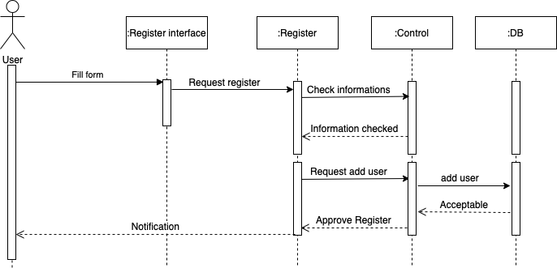
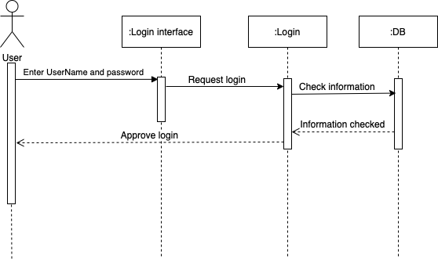
System Design Sequence diagrams

Slide 12
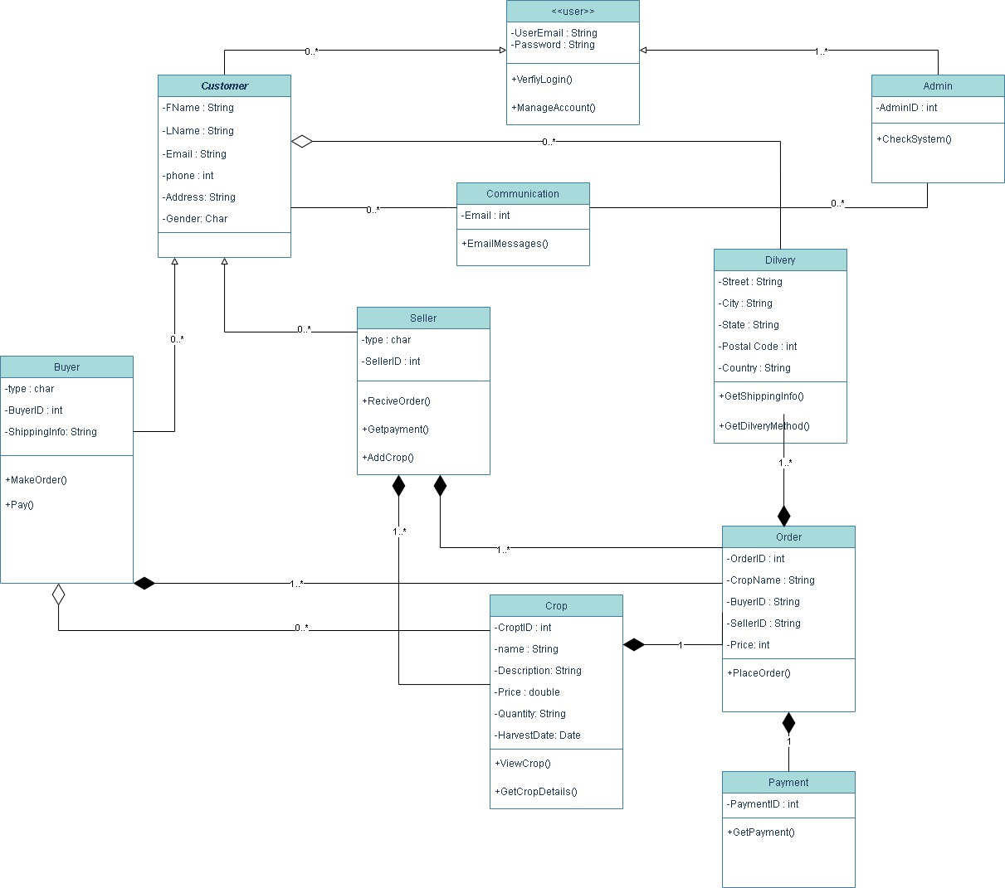
System class diagram

Slide 13

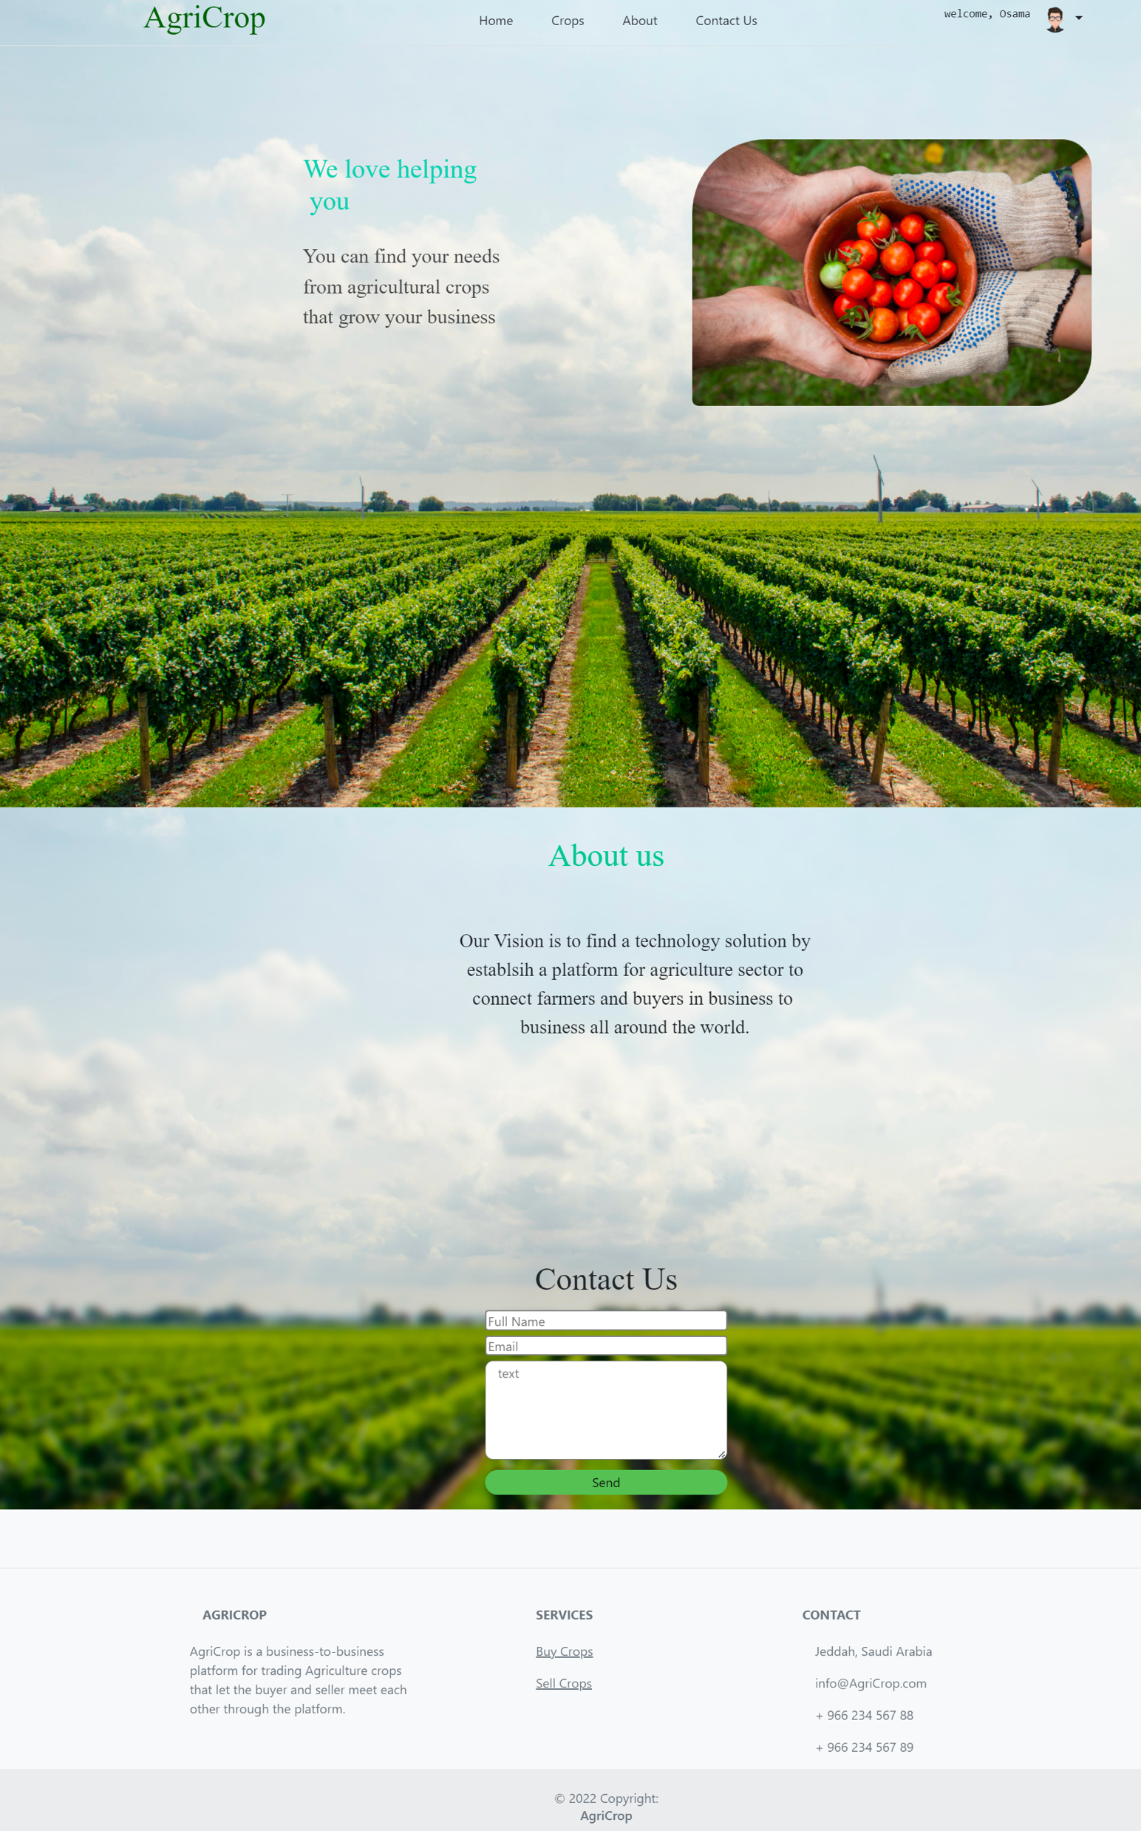
Interface Design
Home Page
simple interface with clear picture of Crop Background with header and footer
description about the website. also it has contact us section for users who want to give a feedback
Changeable Header depend on the user if he login or not as shown

Slide 14
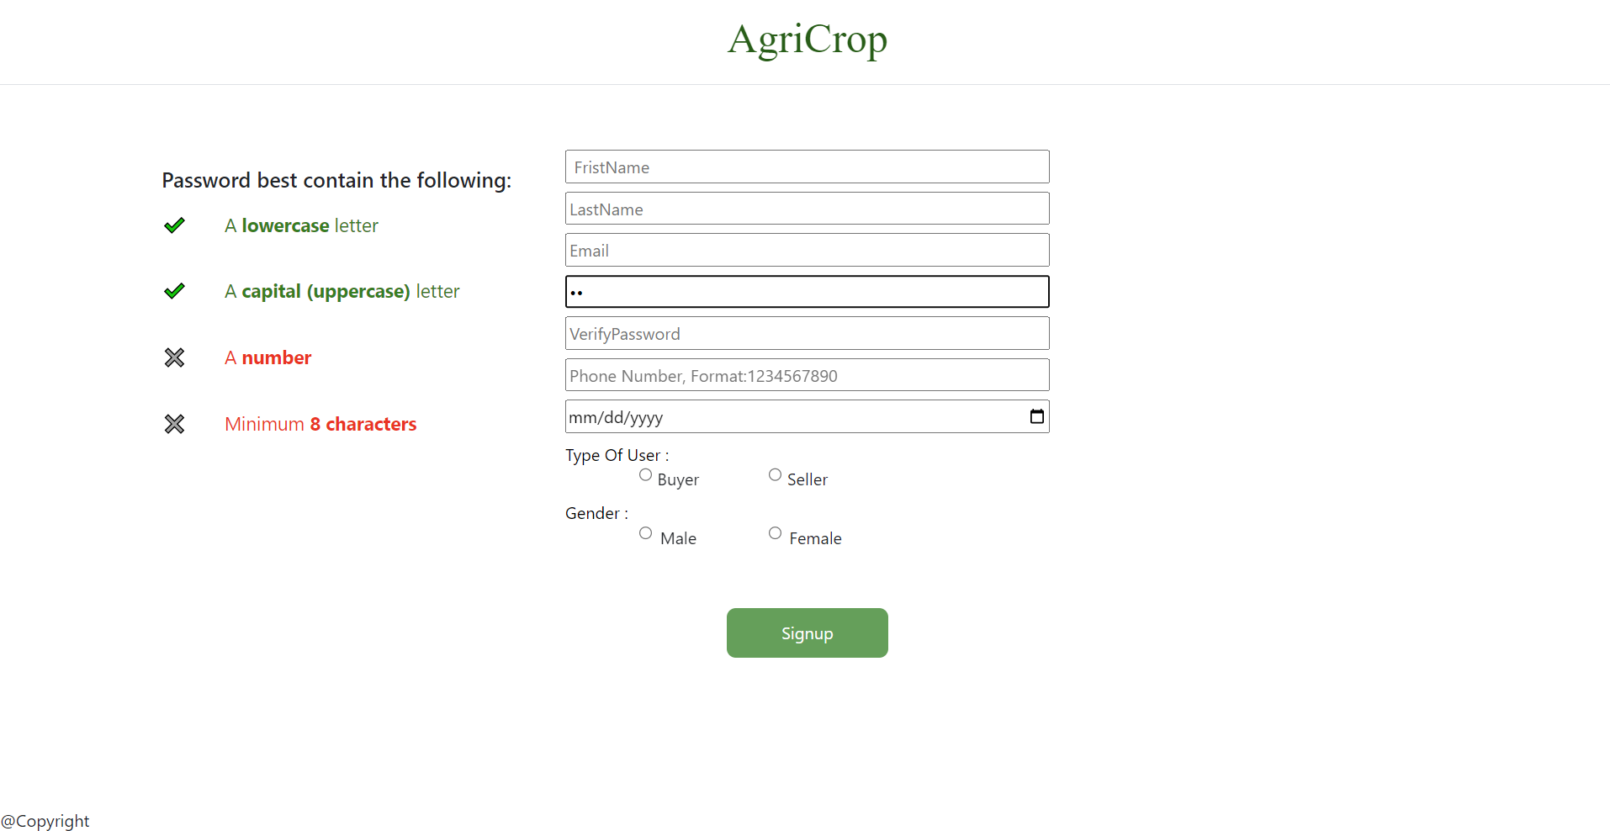
Interface Design
Signup Page
Clear and Simple sign up page With Password Creiteria , user enter his information
And the page will shows if the password meet or not as shown in

Slide 15
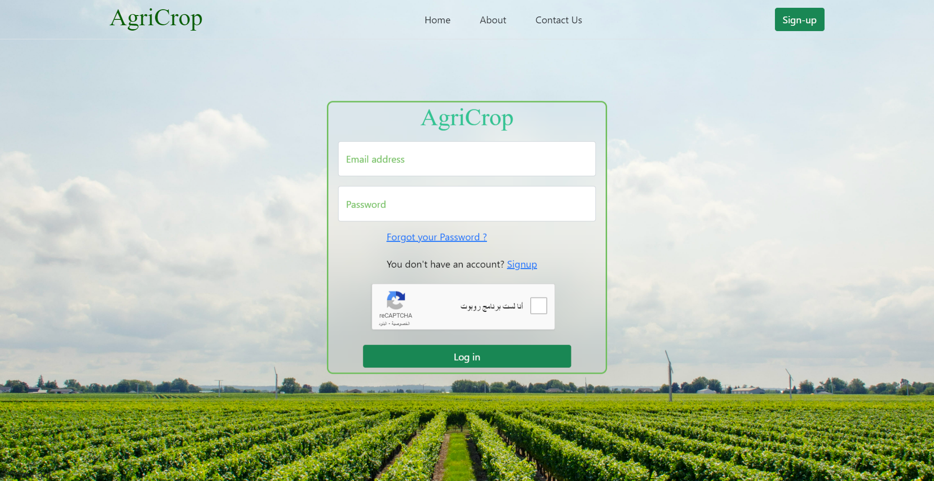
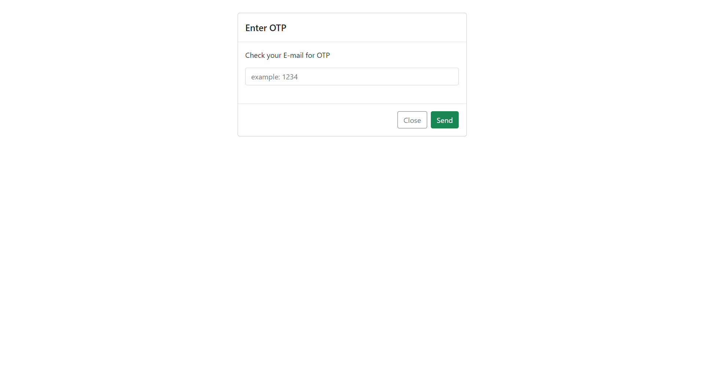
Interface Design
Login Page
log in page contain box that include email and password to log in, as well as reCAPTCHA and login button and also forget password and signup link
After log in the user will go to OTP page (one time password) to verifyhis log in as shown

Slide 16
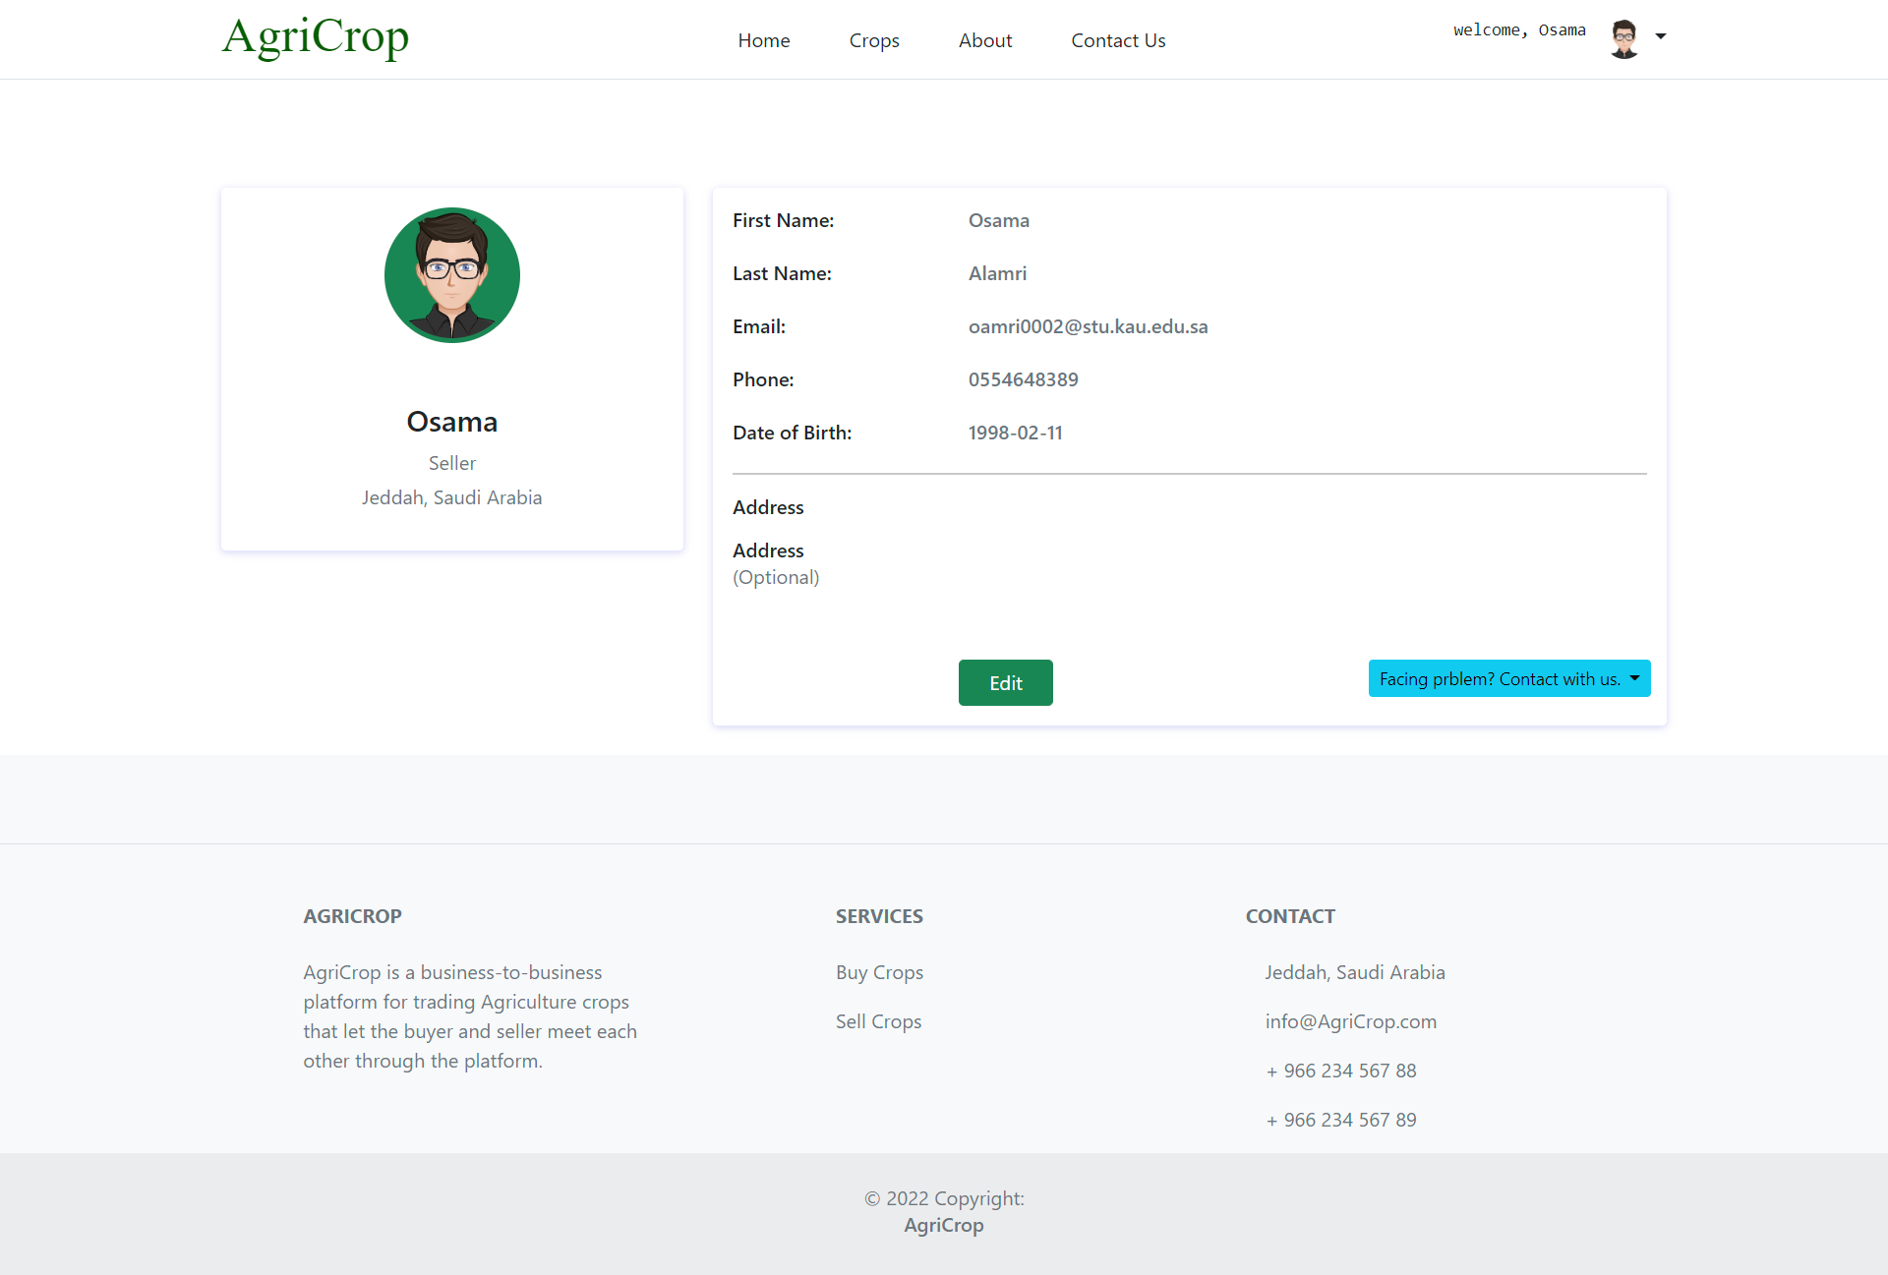
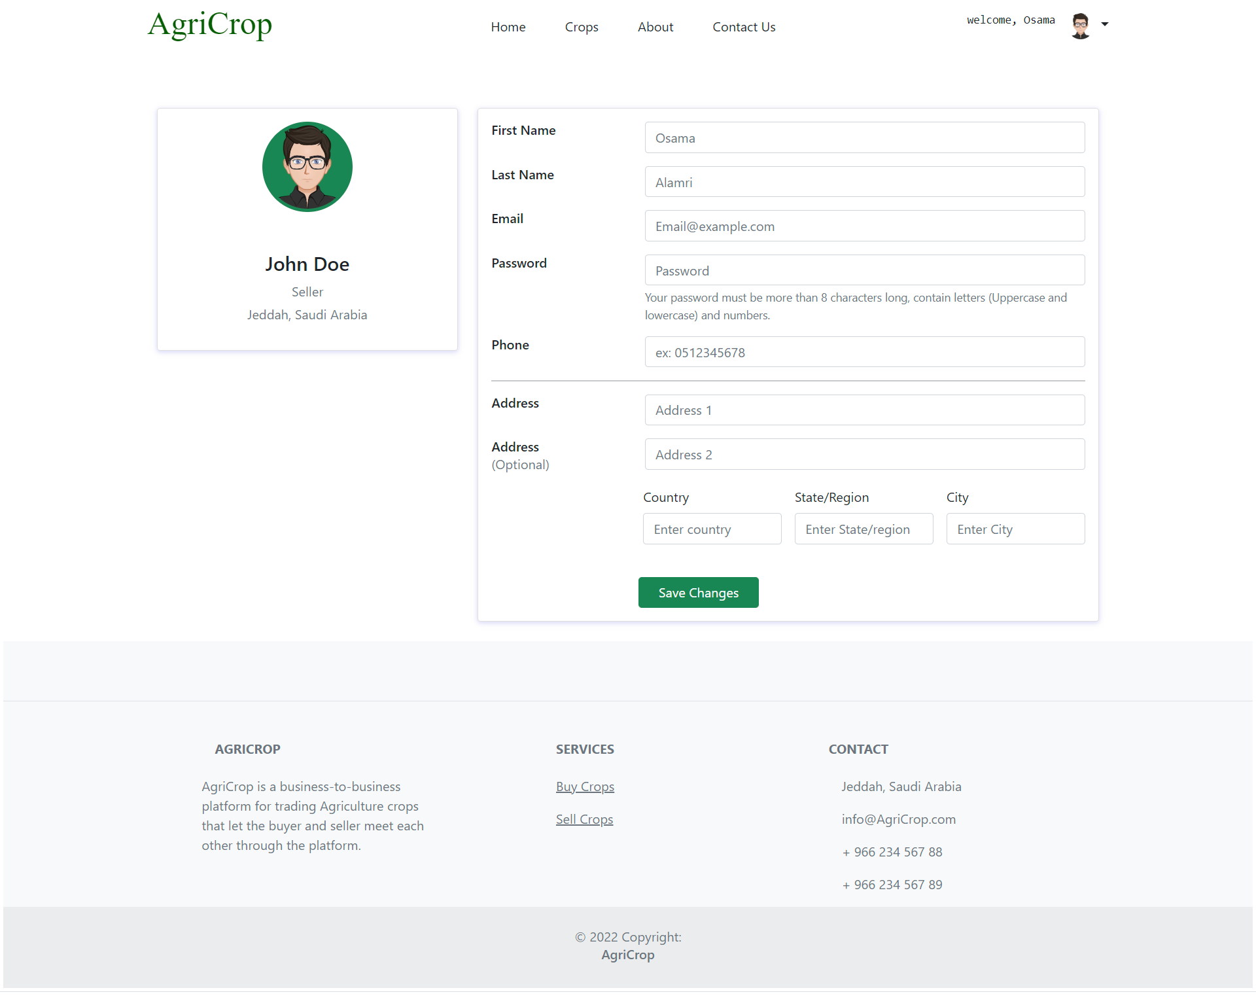
Interface Design
profile page
in this page, we use a template to show the information of the user as shown
We use bootstrap template organize the page, also drop menu if user want to contact with admin
there is also another page if you and to edit the information of the profile as shown

Slide 17
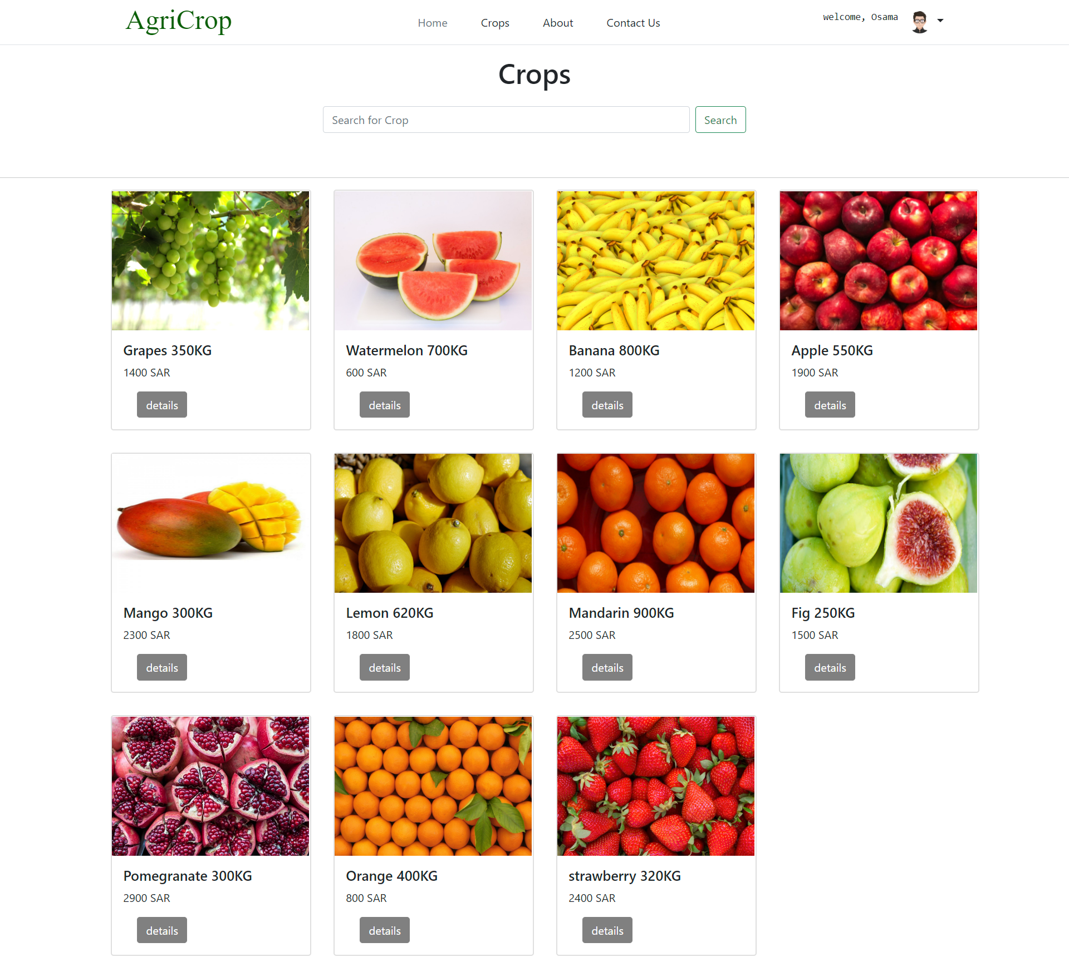
Interface Design
Crop page
in crop page, you can see crops as boxes, every box has a crop that contain picture of the crop
name, price, and weight. there is more than 5 crops to make the interface clear.

Slide 18
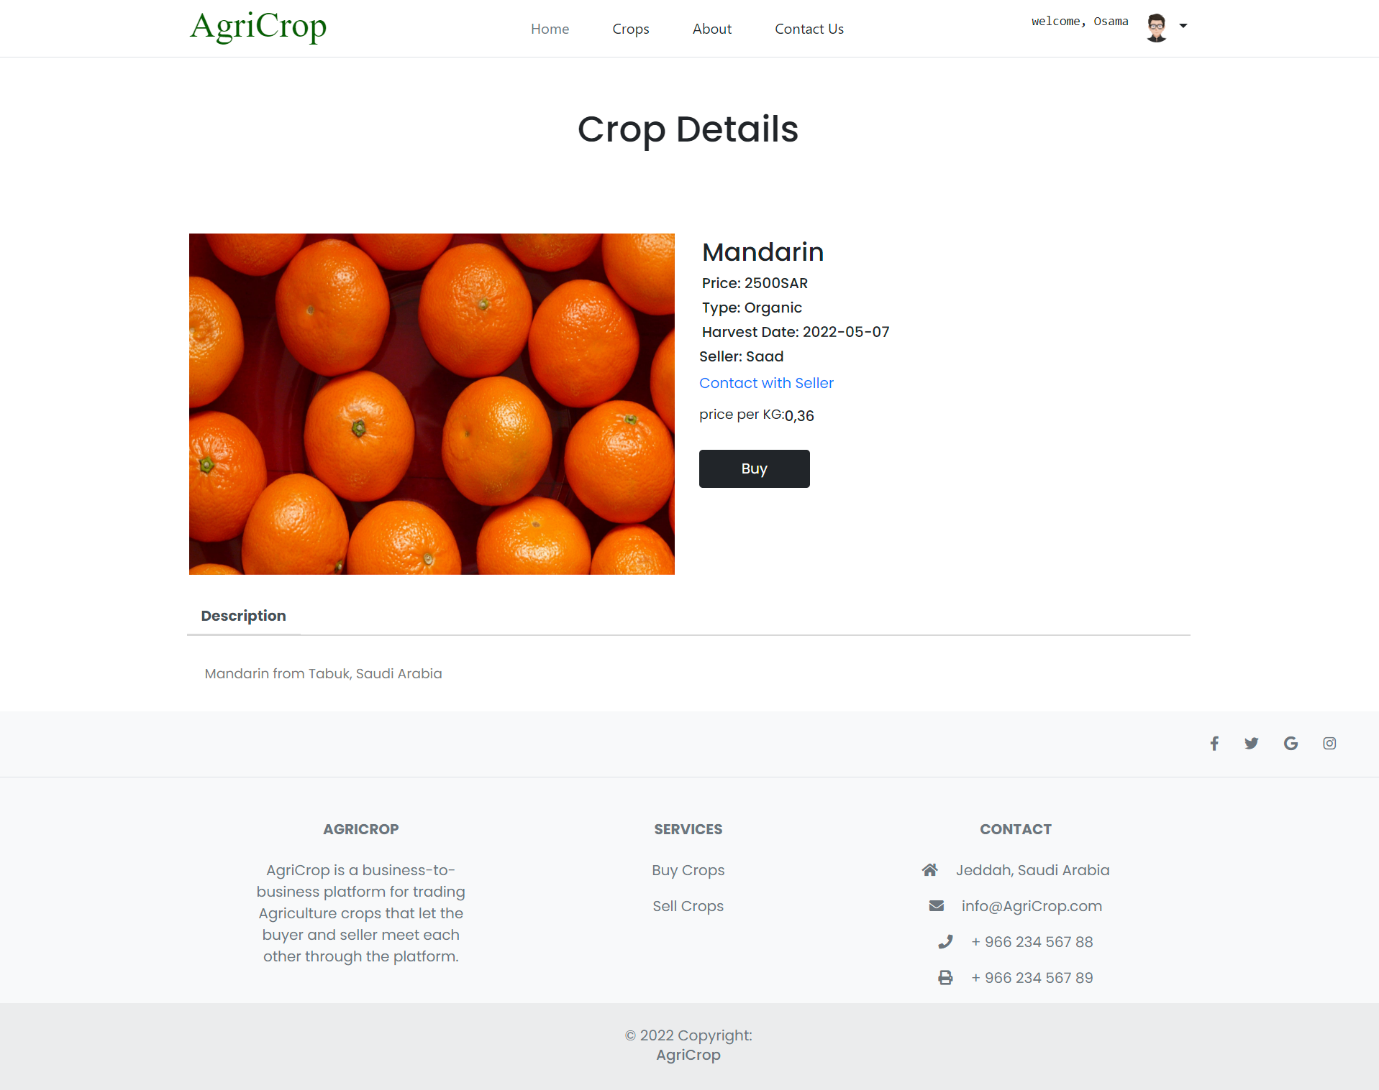
Interface Design
Crop Details page
in details page, you can see the name of crop, picture, the price, the type, Harvest date, seller Name and a hyper link If you want contact with then seller , price per KG, and brief description about the crop.
And Buy Button that will take you to the checkout page

Slide 19
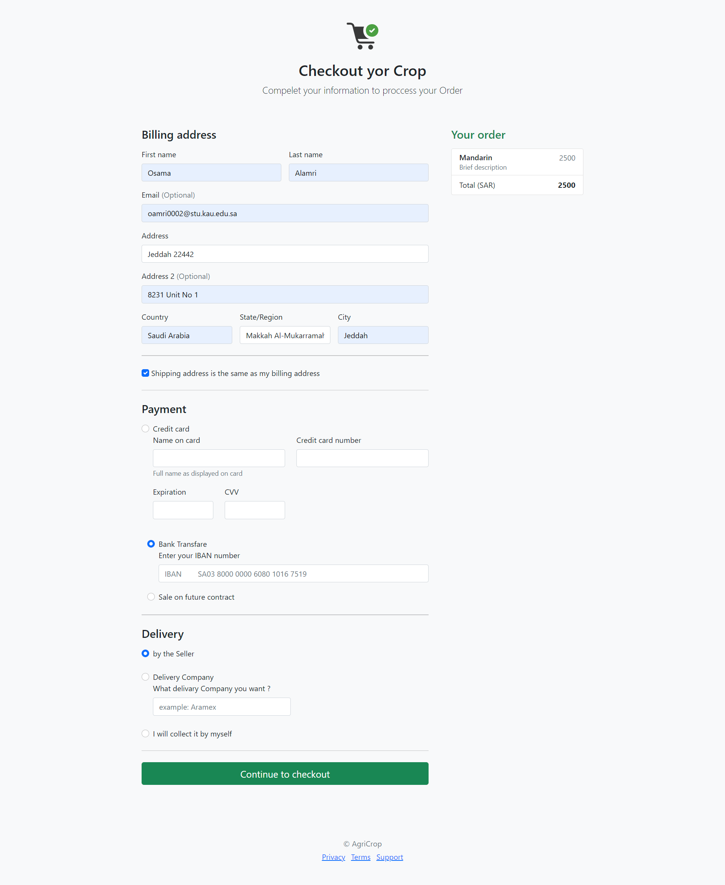
Interface Design
Checkout page
checkout page contain the main important information like order information, billing address, payment method, and delivery options

Slide 20
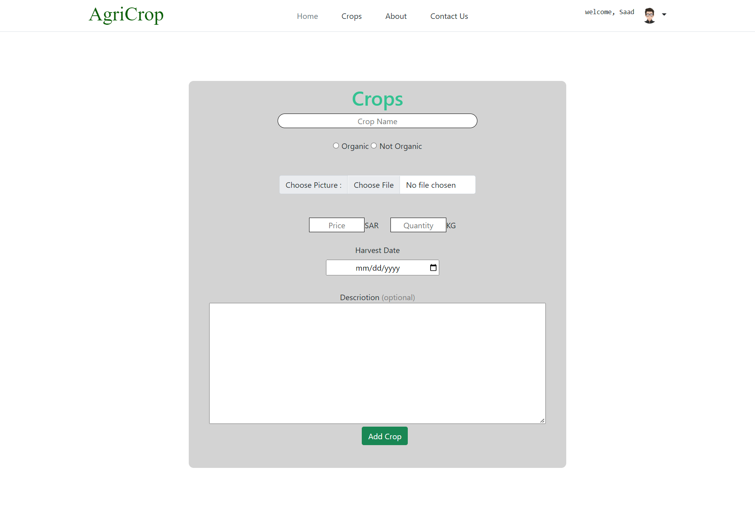
Interface Design
Add Crop page
Add Crop page is a seller to add his crop into the platform
Seller will enter the information about the crop like: name of crop. organic or not, add a picture about the crop
add the quantity per KG ,add the price, add the harvest date, and add a description aboutthe crop.

Slide 21
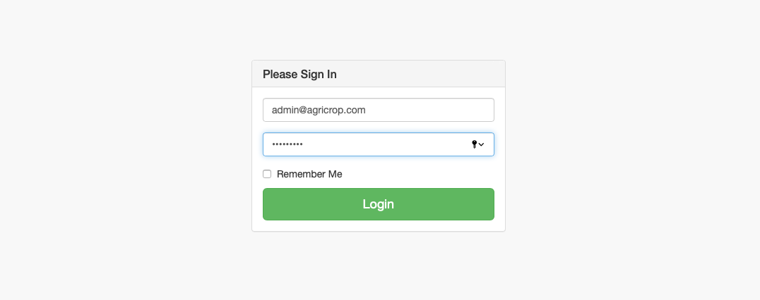
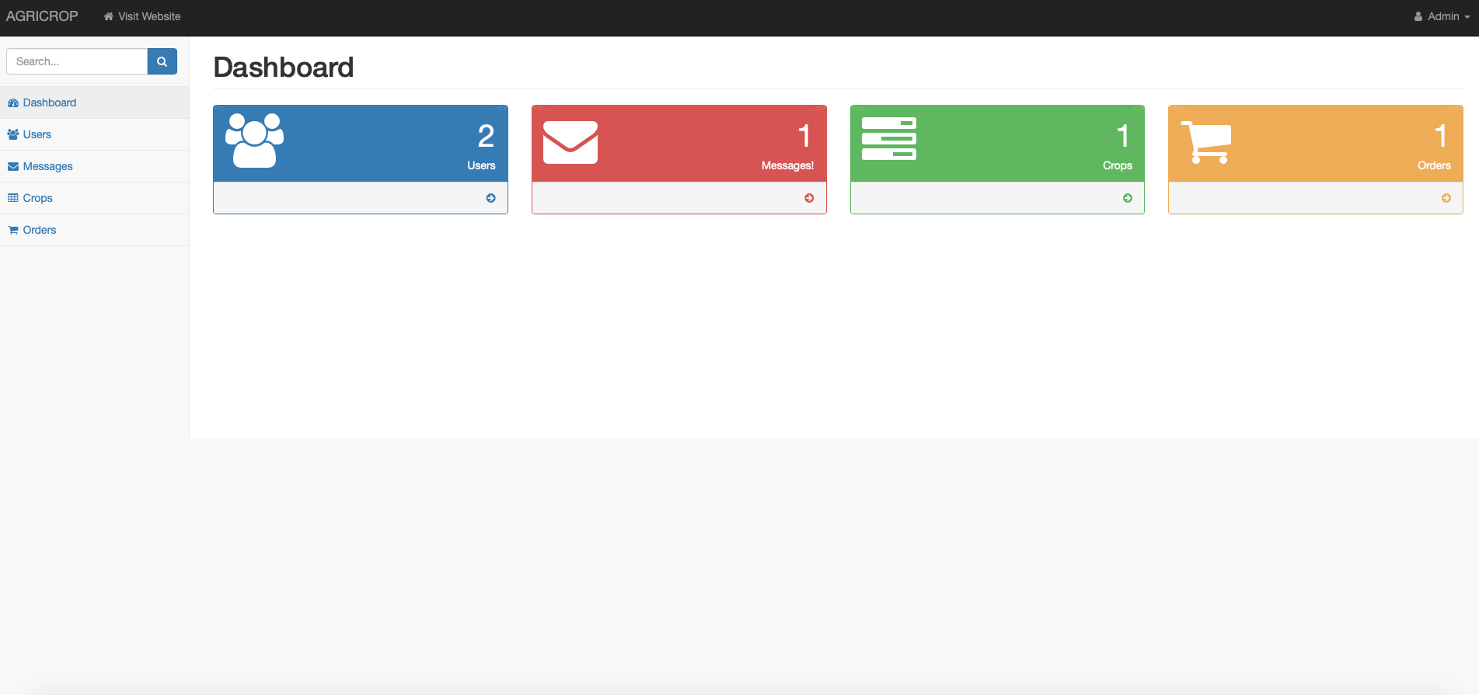
Interface Design
Admin Page

Slide 22



Implementation (Tools)
Front-End
1. HTML
2. CSS
3. JavaScript
We also used a framework and web Techniques for User-Interface like Bootstrap And AJAX
Back-End:
1. PHP
Server and Database
Xampp “Apache” And My SQL
Code Editor:
1. Visual Studio

Slide 23
Conclusion Problems and Difficulties :
choosing the idea:
Finding idea that help people and make their life easier .
lack of recourse:
finding similar work is also limited and causes some difficulties to implement in real
life. also, how to apply it as a technical solution to.
lack of participation in survey:
number of participation in survey was only 29, small number but
all of them either Farmer or business owner.
interface design:
in the beginning of the implementation phase, we depend only on CSS and that cause poor
design interface in some pages

Slide 24
Problems and Difficulties :
choosing the idea:
Finding idea that help people and make their life easier .
lack of recourse:
finding similar work is also limited and causes some difficulties to implement in real
life. also, how to apply it as a technical solution to.
lack of participation in survey:
number of participation in survey was only 29, small number but
all of them either Farmer or business owner.
interface design:
in the beginning of the implementation phase, we depend only on CSS and that cause poor
design interface in some pages

Slide 25
Findings :
there is not a single platformin the localmarket in this field, people still use an old way.
developing something new for the people is not easy
we must consider amount of effort and work to make it right.
uses of frameworks enhance the quality of the project also reduce the time in implementation
phase

Slide 26
Conclusion
in conclusion , The field of agriculture is an important and effective field in our life ، It can contribute to solving many problems if it is activated more and better, and among these problems are unemployment and reducing foreign agriculture imports
This project was created to help and facilitate for everyone, such as the individuals' farmers and the big supermarket companies
we completely believe our project will greatly help developing the agriculture field

Slide 27
Future Work
we might involve new generation of innovation in the project like we can use our self-driving
system to deliver the crops
integrate the Artificial intelligent through the system to make the farmer take a picture for the crop and the AI will recognize the type of crop.
also match the buyers and sellers based on their interest to make log termrelationship in business between them.

Slide 28
Summary
Problem Statement & Objectives
Related Work & Analysis
Data Collection & Requirement Specification
System Structure & System Design
Future work

